Slide 1


Binary Decision Diagrams (BDD)
Testing & Verification
Dept. of Computer Science & Engg, IIT Kharagpur
Pallab Dasgupta
Professor, Dept. of Computer Science & Engg.,
Professor-in-charge, AVLSI Design Lab,
Indian Institute of Technology Kharagpur

Slide 2

Contents
Motivation for Decision diagrams
Binary Decision Diagrams
ROBDD
Effect of Variable Ordering on BDD size
BDD operations
Encoding state machines
Reachability Analysis using OBDDs

Slide 3
Sample Analysis Task
Logic Circuit Comparison
  Do circuits compute identical function?
    Basic task of formal hardware verification
    Compare new design to “known good” design
A
T
1
A
T
O
3
C
1
B
O
2
B
C
T
2

Slide 4
Solution by Combinatorial Search
Satisfiability Formulation
  Search for input assignment giving different outputs
Branch & Bound
  Assign input(s)
  Propagate forced values
  Backtrack when cannot succeed
0
0
1
A
0
T
A
A
A
A
A
A
T
T
T
T
T
1
T
1
0
3
3
3
3
3
3
1
3
O
O
O
O
O
O
0
1
O
0
1
B
0
2
B
B
B
B
B
B
2
2
2
2
2
1
2
0
1
1
1
C
1
C
C
C
C
C
C
Diff
Diff
Diff
Diff
Diff
Diff
Diff
0
1
0
0
T
T
T
T
T
T
0
T
A
1
A
A
A
A
A
A
0
0
0
1
1
1
1
1
1
1
0
0
0
0
1
1
0
0
1
1
1
1
1
0
C
C
C
C
C
C
C
O
O
O
O
O
O
1
O
0
0
1
1
1
1
1
1
1
1
B
0
B
B
B
B
B
B
T
T
T
T
T
T
T
2
2
2
2
2
2
2
Challenge
  Must prove all assignments fail
  Typically explore significant fraction of inputs
  Exponential time complexity
c
c
c
c
c
c
c
0
1
1
1
1
1
a
a
a
a
0
0
0
1
b
b
0
1

Slide 5
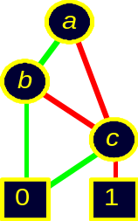
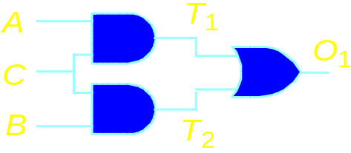
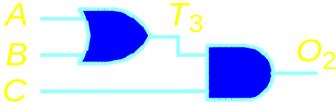
Another Approach
Generate Complete Representation of Circuit Function
  Compact, canonical form
  Functions equal if and only if representations identical
  Never enumerate explicit function values
  Exploit structure & regularity of circuit functions

Slide 6
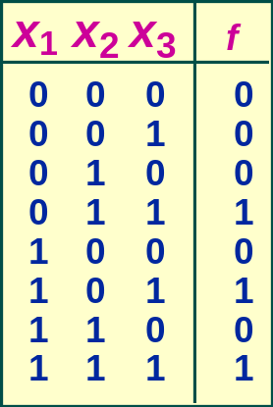
Decision Structure
Truth Table
Decision Tree
x
1
x
2
x
2
x
3
x
3
x
3
x
3
0
0
0
1
0
1
0
1
  Vertex represents decision
  Follow green (dashed) line for value 0
  Follow red (solid) line for value 1
  Function value determined by leaf value.

Slide 7
Binary Decision Diagram
DAG representation of Boolean functions
Operations on Boolean functions can be implemented as graph algorithms on BDDs
Tasks in many problem domains can be expressed entirely in terms of BDDs
BDDs have been useful in solving problems that would not be possible by more traditional techniques.

Slide 8
Binary Decision Diagram (BDD)
Each non-terminal vertex v is labeled by a variable var(v) and has arcs directed toward two children
  lo(v) (dotted line) corresponding to the case where the variable is assigned 0
  hi(v) (solid line) where the variable is assigned 1
Each terminal vertex is labeled as 0 or 1
For a given assignment to the variables, the value of the function is determined by tracing the path form root to a terminal vertex, following the branches appropriately

Slide 9
BDDs and Shannon’s Expansion
Shannon’s Expansion: f = xf_{x} + x′f_{x′}
BDD represents recursive application of Shannon’s expansion
f
x
f_{x′}
f_{x}

Slide 10
Ordered Binary Decision Diagram (OBDD)
  Assign arbitrary total ordering to variables
    e.g. x₁ < x₂ < x₃
  Variables must appear in ascending order along all paths
x
1
x
1
x
3
x
1
OK
Not OK
x
2
x
2
x
3
x
3
x
1
x
3
Properties
  No conflicting variable assignments along path
  Simplifies manipulation

Slide 11
Reduction Rule #1
Eliminate all but one terminal
vertex with a given label and redirect
all arcs into the eliminated vertices
to the remaining
Merge equivalent leaves
0
0
0
x
1
x
1
x
2
x
2
x
2
x
2
x
3
x
3
x
3
x
3
x
3
x
3
x
3
x
3
0
0
0
1
0
1
0
1
0
1

Slide 12
Reduction Rule #2
If non-terminal vertices u and v have
var(u) = var(v), lo(u) = lo(v) and
hi(u) = hi(v), eliminate one of them
and redirect all incoming arcs
to the other
Merge isomorphic nodes
x
x
x
x
x
x
y
z
y
z
y
z
x
1
x
1
x
2
x
2
x
2
x
2
x
3
x
3
x
3
x
3
x
3
x
3
0
1
0
1

Slide 13
Reduction Rule #3
If non-terminal vertex v has
lo(v) = hi(v), eliminate v and
redirect all incoming
arcs to lo(v)
Eliminate Redundant Tests
x
y
y
x
1
x
1
x
2
x
2
x
2
x
3
x
3
x
3
0
1
0
1

Slide 14

Reduced OBDD (ROBDD)
Initial Graph
Reduced Graph
x
1
x
1
x
2
x
2
x
2
x
3
x
3
x
3
x
3
x
3
0
0
0
1
0
1
0
1
0
1
Canonical representation of Boolean function
For the same variable ordering, two functions equivalent if and only if graphs isomorphic
    Can be tested in linear time

Slide 15


Some Example Functions
Constants
Variable
Unique unsatisfiable function
x
Treat variable
as function
Unique tautology
0
1
Typical Function
Odd Parity
x
1
(x₁ ∨ x₂ ) ∧ x₄
No vertex labeled x₃
  independent of x₃
Many subgraphs shared
x
1
x
2
x
2
x
2
Linear
representation
x
3
x
3
x
4
x
4
x
4
0
1
0
1

Slide 16
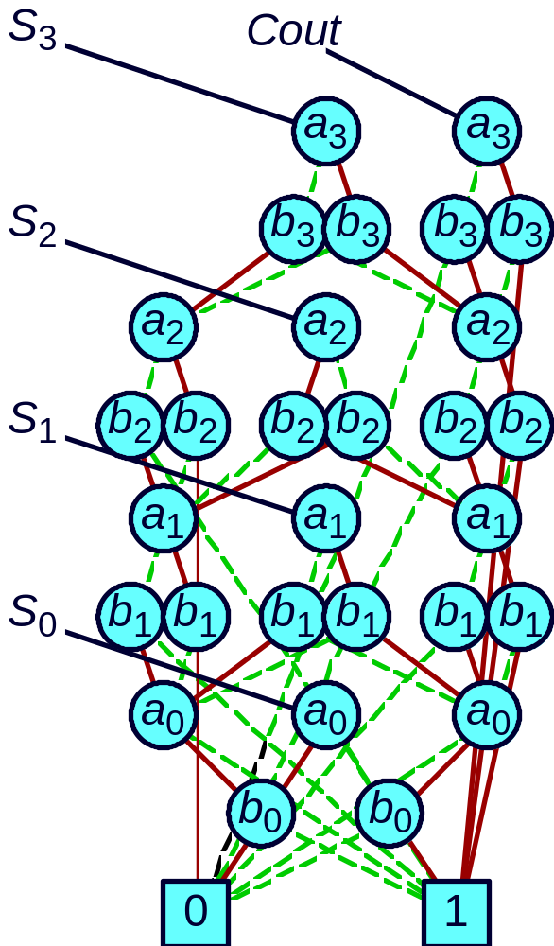
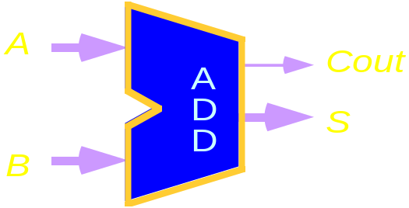
Circuit Functions
Functions
  All outputs of 4-bit adder
  Functions of data inputs
Shared Representation
  Graph with multiple roots
  31 nodes for 4-bit adder
  571 nodes for 64-bit adder
  Linear Growth

Slide 17
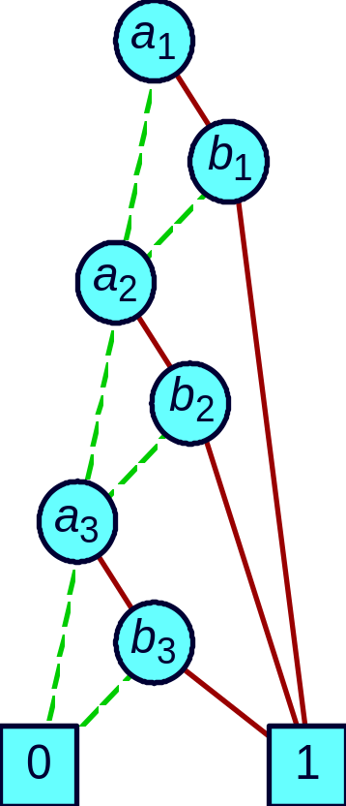
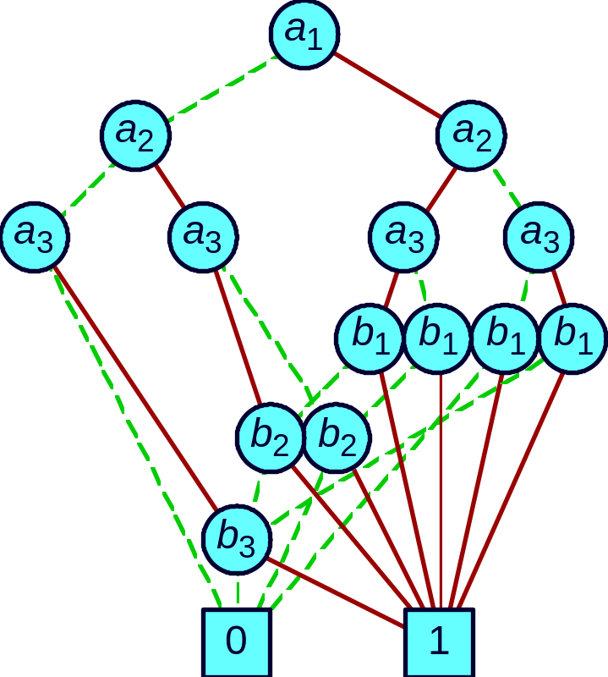
Effect of Variable Ordering on ROBDD Size
(
a
∧
b
)
∨
(
a
∧
b
)
∨
(
a
∧
b
)
1
1
2
2
3
3
Good Ordering
Bad Ordering
(a₁ < b₁ < a₂ < b₂ < a₃ < b₃)
(a₁ < a₂ < a₃ < b₁< b₂ < b₃)
Linear Growth
Exponential Growth

Slide 18
Analysis of Ordering Example
(
a
1
∧
b
1
)
∨
(
a
2
∧
b
2
)
∨
(
a
3
∧
b
3
)
K = 2
K = n

Slide 19
Selecting a good Variable Ordering
Intractable Problem
  Even when problem represented as OBDD
A good variable ordering should use
  Local computability
  Ordering based on power to control output
Application-Based Heuristics
  Exploit characteristics of application
    Ordering for functions of combinational circuit
    Traverse circuit graph depth-first from outputs to inputs
    Assign variables to primary inputs in order encountered

Slide 20
Dynamic Variable Ordering
Rudell, ICCAD ‘93
Concept
  Variable ordering changes as computation progresses
    Typical application involves long series of BDD operations
  Proceeds in background, invisible to user
Implementation
  When approach memory limit, attempt to reduce
    Garbage collect unneeded nodes
    Attempt to find better order for variables
  Simple, greedy reordering heuristics

Slide 21
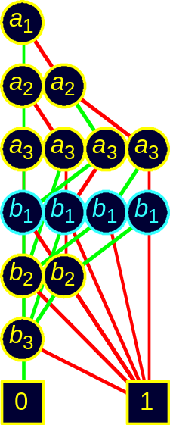
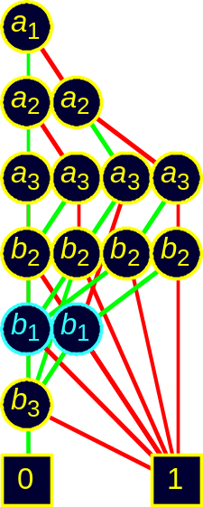
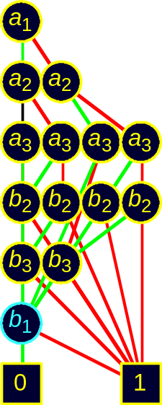
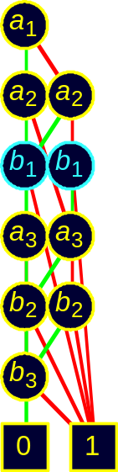
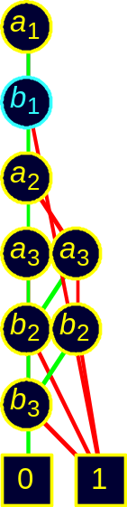
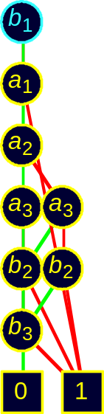
Dynamic Reordering By Sifting
  Choose candidate variable
  Try all positions in ordering
    Repeatedly swap with adjacent variable
  Move to best position found
Best
Choices
• • •

Slide 22
Sample Function Classes
Function Class Best Worst Ordering Sensitivity
ALU (Add/Sub) linear exponential High
Symmetric linear quadratic None
Multiplication exponential exponential Low
General Experience
  Many tasks have reasonable OBDD representations
  Algorithms remain practical for up to 100,000 node OBDDs
  Heuristic ordering methods generally satisfactory

Slide 23
BDD Operations
Strategy
  Represent data as set of OBDDs
    Identical variable orderings
  Express solution method as sequence of symbolic operations
  Implement each operation by OBDD manipulation
Algorithmic Properties
  Arguments are OBDDs with identical variable orderings.
  Result is OBDD with same ordering.
  “Closure Property”

Slide 24
The APPLY Operation
Given argument functions f and g, and a binary operator <op>, APPLY returns the function f <op> g
Works by traversing the argument graphs depth first
Algebraic operations “commute” with the Shannon expansion for any variable x
  f <op> g = x’ (f|_{x=0} <op> g|_{x=0} ) + x ((f|_{x=1} <op> g|_{x=1})

Slide 25
The Apply Algorithm
Consider a function f represented by a BDD with root vertex r_{f}
The restriction of f with respect to a variable x such that x ≤ var(r_{f}) can be computed as :
  f | _{x = b} = r_{f} , x < var(r_{f} )
= lo(r_{f}), x = var (r_{f}) and b = 0
= hi(r_{f}), x = var (r_{f}) and b = 1
The algorithm for APPLY utilizes the above restriction definition.

Slide 26
The Apply Algorithm
Each evaluation step is identified by a vertex from each of the argument graphs
Suppose functions f and g are represented by root vertices r_{f} and r_{g}
If r_{f} and r_{g} are both terminal vertices, terminate and return an appropriately labeled terminal vertex e.g. (A₄, B₃) and (A₅, B₄)

Slide 27
The Apply algorithm
Let x be the splitting variable
( x= min(var(r_{f}) , var(r_{g}))
BDDs for (f|_{x=0} <op> g|_{x=0} ) and (f|_{x=1} <op> g|_{x=1} ) are computed by recursively evaluating the restrictions of f and g for value 0 and for value 1

Slide 28
Example
Recursive Calls
A
1
a
a
B
1
A
1
,
B
1
A
2
b
A
2
,
B
2
c
A
6
c
B
5
A
6
,
B
2
A
6
,
B
5
A
3
d
B
2
d
A
3
,
B
2
A
5
,
B
2
A
3
,
B
4
A
4
0
1
A
5
B
3
0
1
B
4
A
4
,
B
3
A
5
,
B
4
Initial evaluation with vertices A₁, B₁ causes recursive evaluations with vertices A₂, B₂ and A₆, B₅

Slide 29
Apply operation
Reaching a terminal with a dominant value (e.g 1 for OR, 0 for AND) terminates recursion and returns an appropriately labeled terminal (A₅, B₂ and A₃, B₄)
Avoid multiple recursive calls on the same pair of arguments by a hash table (A₃, B₂ and A₅, B₂)

Slide 30
Apply operation
Each evaluation step returns a vertex in the generated graph
Apply reduction before merging the result
Complexity of operation : O(m_{f} * m_{g}) where m_{f} and m_{g} represent the number of vertices in the BDDs for f and g respectively

Slide 31
Example
Recursive Calls
Without Reduction
With Reduction
A
1
,
B
1
a
a
C
6
A
2
,
B
2
b
C
5
b
C
4
A
6
,
B
2
A
6
,
B
5
c
c
c
A
3
,
B
2
A
5
,
B
2
A
3
,
B
4
d
1
1
C
3
d
A
4
,
B
3
A
5
,
B
4
0
1
C
1
0
1
C
2

Slide 32
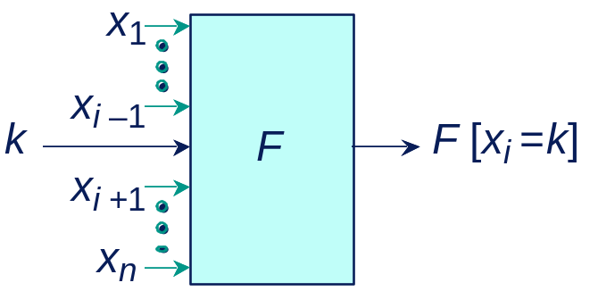
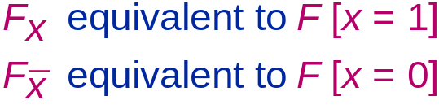
Restrict Operation
Concept
  Effect of setting function argument x_{i} to constant k (0 or 1).
  Also called Cofactor operation

Slide 33
Restriction Algorithm
Implementation
  Depth-first traversal
  Redirect any arc into vertex v having var(v) = x to point to hi(v) for x =1 and lo(v) for x = 0
  Complexity linear in argument graph size

Slide 34
Restriction Execution Example
Argument F
Restriction F[b=1]
Reduced Result
a
a
b
c
c
c
d
d
d
0
1
0
1
0
1

Slide 35
Derived Operations
  Express as combination of Apply and Restrict
  Preserve closure property
    Result is an OBDD with the right variable ordering
  Polynomial complexity
    Although can sometimes improve with special implementations

Slide 36
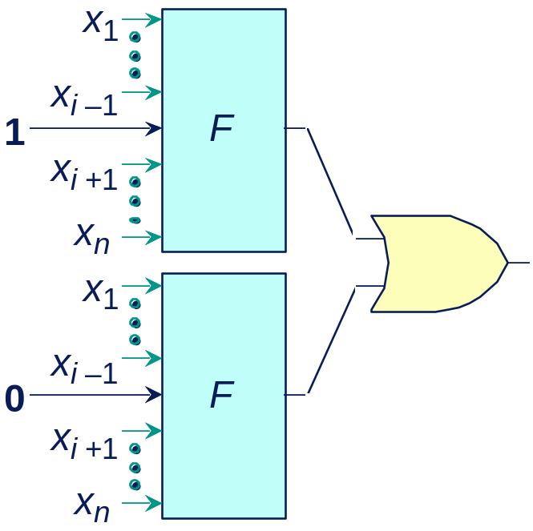
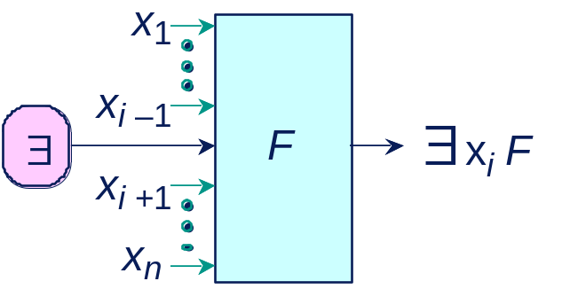
Variable Quantification
  Eliminate dependency on some argument through quantification
  Combine with AND for universal quantification.

Slide 37
Digital Applications of BDDs
Verification
  Combinational equivalence (UCB, Fujitsu, Synopsys, …)
  FSM equivalence (Bull, UCB, MCC,Colorado, Torino, …)
  Symbolic Simulation (CMU, Utah)
  Symbolic Model Checking (CMU, Bull, Motorola, …)
Synthesis
  Don’t care set representation (UCB, Fujitsu, …)
  State minimization (UCB)
  Sum-of-Products minimization (UCB, Synopsys, NTT)
Test
  False path identification (TI)

Slide 38
Some Popular BDD packages
CUDD (Colorado University Decision Diagram)
TUD BDD package (TUDD)
BUDDY
CMU BDD
Informations about the above BDD packages and some
more details can be found at http://www.bdd-portal.org/

Slide 39
Finite State System Analysis
Systems Represented as Finite State Machines
  Analysis Tasks
  State reachability
  State machine comparison
  Temporal logic model checking
Traditional Methods Impractical for Large Machines
  Polynomial in number of states
  Number of states exponential in number of state variables.
  Example: single 32-bit register has 4,294,967,296 states!

Slide 40
Symbolic FSM Representation
  Represent set of transitions as function δ(Old, New)
    Yields 1 if can have transition from state Old to state New
  Represent as Boolean function
    Use variables for encoding states

Slide 41
Symbolic FSM Representation
Nondeterministic FSM
Symbolic Representation
n
1
00
01
n
2
o
1
,
o
2
encoded
o
1
old state
n
1
,
n
2
encoded
10
11
o
o
new state
2
2
0
1

Slide 42
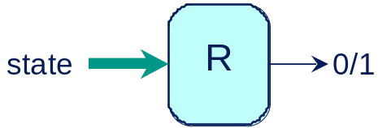
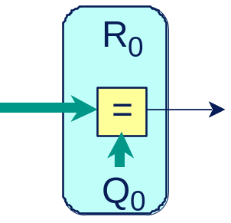
Reachability Analysis
  Compute set of states reachable from initial state (Q₀ = 00)
  Represent as Boolean function R(S)
Given
Compute
old state
δ
0/1
new state
Initial

Slide 43
Breadth-First Reachability Analysis
R₃
R₂
R₂
R₁
R₁
R₁
R₀
R₀
R₀
R₀
00
01
01
01
01
10
00
10
00
00
00
10
11
  R_{i} – set of states that can be reached in i transitions
  Reach fixed point when R_{n} = R_{n+1}
    Guaranteed since finite state

Slide 44
Iterative Computation
R
i
+1
R
i
∃
old
δ
new
R
i
  R_{i +1} – set of states that can be reached within i +1 transitions
    Either in R_{i}
    or single transition away from some element of R_{i}

Slide 45
Example: Computing R₁ from R₀
n
n
1
1
R₀
n
n
2
2
00
o
1
1
0
0
o
2
o
2
∃ Old [R₀(Old) ∧ δ(Old, New)]
0
1
n
1
R₁
n
2
n
1
00
01
1
0
1
0
0

Slide 46
What’s good about OBDDs ?
Powerful Operations
  Creating, manipulating, testing
  Each step polynomial complexity
    Graceful degradation
  Maintain “closure” property
    Each operation produces form suitable for further operations
Generally Stay Small Enough
  Especially for digital circuit applications
  Given good choice of variable ordering
Weak Competition

Slide 47
What’s not good about OBDDs?
Doesn’t Solve All Problems
  Can’t do much with multipliers
  Some problems just too big
  Weak for search problems
Must be Careful
  Choose good variable ordering
  Some operations too hard

Slide 48
Zero Suppressed BDD’s - ZBDD’s
ZBDD’s were invented by Minato to efficiently represent sparse sets. They have turned out to be extremely useful in implicit methods for representing primes (which usually are a sparse subset of all cubes).
Different reduction rules.

Slide 49
Zero Suppressed BDD’s - ZBDD’s
ZBDD Reduction Rule:: eliminate all nodes where the then node points to 0. Connect incoming edges to else node
For ZBDD, equivalent nodes can be shared as in case of BDDs.
ZBDD:
0
1
0
0
1
0
1

Slide 50
MTBDD- Multiterminal BDD
x₀ + 2x₁ + 4x₂
x
2
x
1
x
1
x
0
x
0
x
0
x
0
0
1
2
3
4
5
6
7
Evaluating a MTBDD for a given variable assignment is similar to that in case of BDD
Very inefficient for representing functions yielding values over a large range

Slide 51
EVBDD – Edge value BDD
EVBDDs can be used when the number of possible function values are too high for MTBDDs.
Evaluating a EVBDD involves tracing a path determined by the variable assignment, summing the weights and the terminal node value
g
x₂
4
x₁
2
x₀
0
1

Slide 52
*BMD( Binary Moment Diagrams )
Features
  Used for Word level simulation/verification
  Canonical
  Based on linear decomposition of a function
Functional Decomposition :
f = (1-x) f_{~x} + (x) f_{x}
= f_{~x} + x ( f_{x} - f_{~x})
= f_{~x} + x ( f._{x} )
where f._{x} is the linear moment w.r.t. x

Slide 53
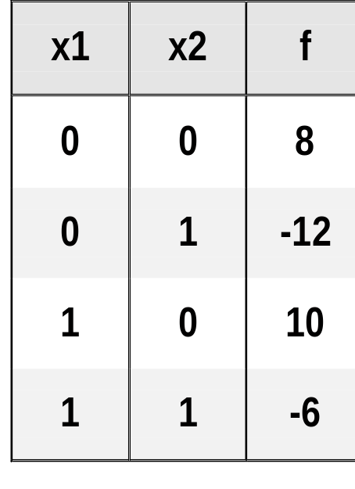
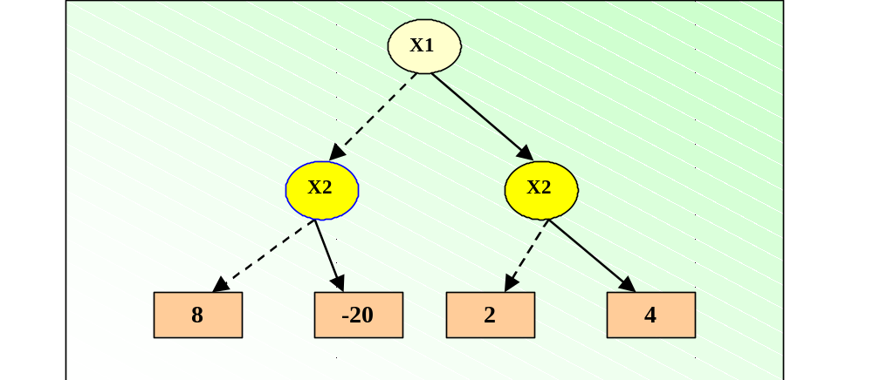
Representing *BMDs
Graph :
  Example
f = (1-x1)(1-x2)(8)+(1-x1)(x2)(-12)
+(x1)(1-x2)(10) + (x1)(x2)(-6)
= 8 - 20(x2) + 2(x1) + 4(x1*x2)

Slide 54
Edge Weights ( *BMDs )
Weights combine multiplicatively along path from root to leaf Rules :
  weights of 2 branches relatively prime
  weight 0 allowed only for terminal vertices
  if one edge has weight 0, the other has weight 1
2
x
x
y
y
2
y
y
2
4
8
-20
BMD
-5
2
1
* BMD

Slide 55
References
Graph Based Algorithms for Boolean Fucntion Manipulation, Randal E. Bryant, IEEE Transactions on Computers, Vol C-35, August 1986, pp. 677-691.
Symbolic Boolean Manipulation with Ordered Binary Decision Diagrams,
Randal E. Bryant, ACM Computing Surveys, 24(3), 1992, pp. 293-318

